Slide 1
Inside the Minds of Nike's Young Consumers: A Marketing Research Study
MKT 5401-01
Instructor: Prof. Ozlem Hesapci Karaca
Team 5: Akancha Poddar Hao Tan Harshini Nagaraju Mihir Mahendra Koyande Yudong Zhao

Slide 2

SWOT Analysis of Nike
Weaknesses: Criticism regarding labor practices in overseas factories Higher prices compared to competitors, which may limit market share in certain segments Dependence on third-party manufacturers, which can impact quality and supply chain management
Strengths: Strong brand reputation and recognition globally Diversified product portfolio, including a wide range of shoes, apparel, and accessories for different sports and activities. Strong marketing campaigns and endorsements from high-profile athletes and celebrities
Opportunities: Growth in e-commerce and online sales, which can expand the reach of the brand globally Partnership opportunities with technology companies to integrate wearable technology into products
Threats: Intense competition from other athletic apparel and footwear brands, such as Adidas and Under Armour Political and economic instability in overseas markets where Nike operates Consumer trends and preferences shifting away from athletic wear and towards more casual styles.

Slide 3
Research Problem
One potential research problem for Nike in the shoes and apparel industry could be how to create sustainable materials and production processes that reduce the company's environmental impact while still meeting consumer demand for high-quality products.
Another research problem could be how to use technology to enhance the performance and functionality of Nike products. This could involve researching new materials and designs that improve comfort, support, and durability, as well as incorporating technology such as sensors or data analysis to help athletes optimize their training and performance.
Additionally, Nike could research how to effectively market and distribute their products to different target audiences. This could involve conducting market research to understand consumer preferences and trends, as well as developing targeted marketing campaigns and distribution strategies to reach specific demographics, such as younger or more environmentally conscious consumers.

Slide 4
Hypotheses
Hypothesis 1: Young customers who prioritize fashion and trends are likelier to purchase Nike products than those who prioritize comfort and function.
Hypothesis 2: Price is a significant factor in the purchasing decisions of young consumers for Nike products.
Hypothesis 3: Product design and customization options have significant impacts on the purchasing decisions of young customers for Nike products.

Slide 5
Methodology
Design and Procedure: Questionnaire
Sample: Target audience
Method of sampling – stratified
Research Technology
Likert scale & Netpromoter score
Analysis tools- SPSS
Questionnaire- Clark Qualtrics

Slide 6
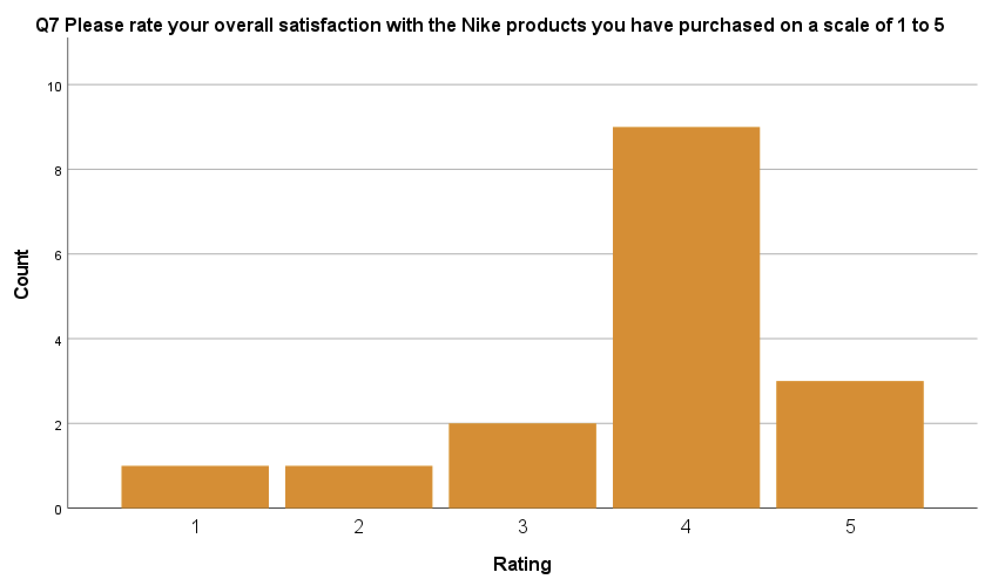
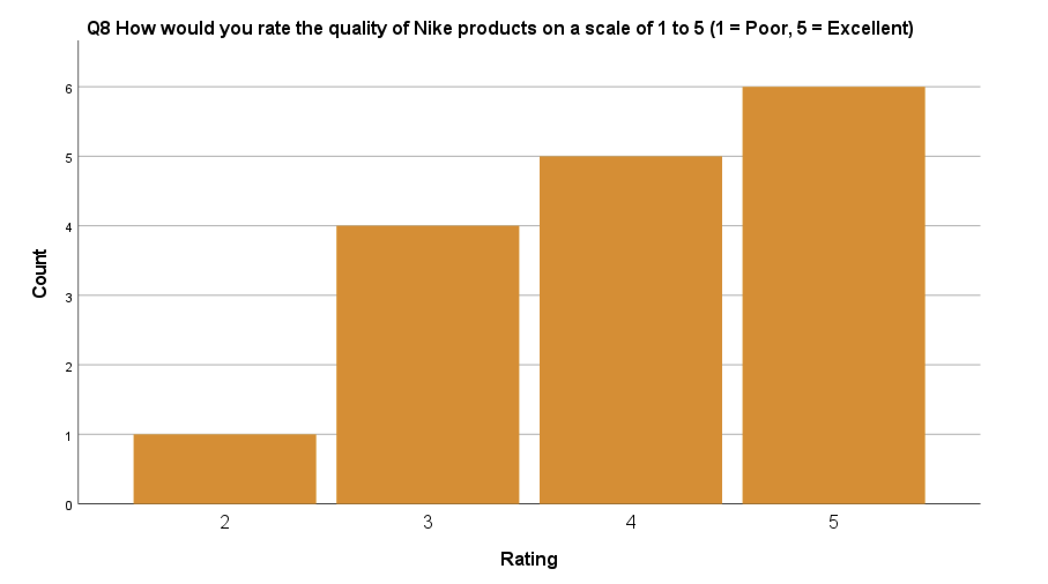
Graphs

Slide 7
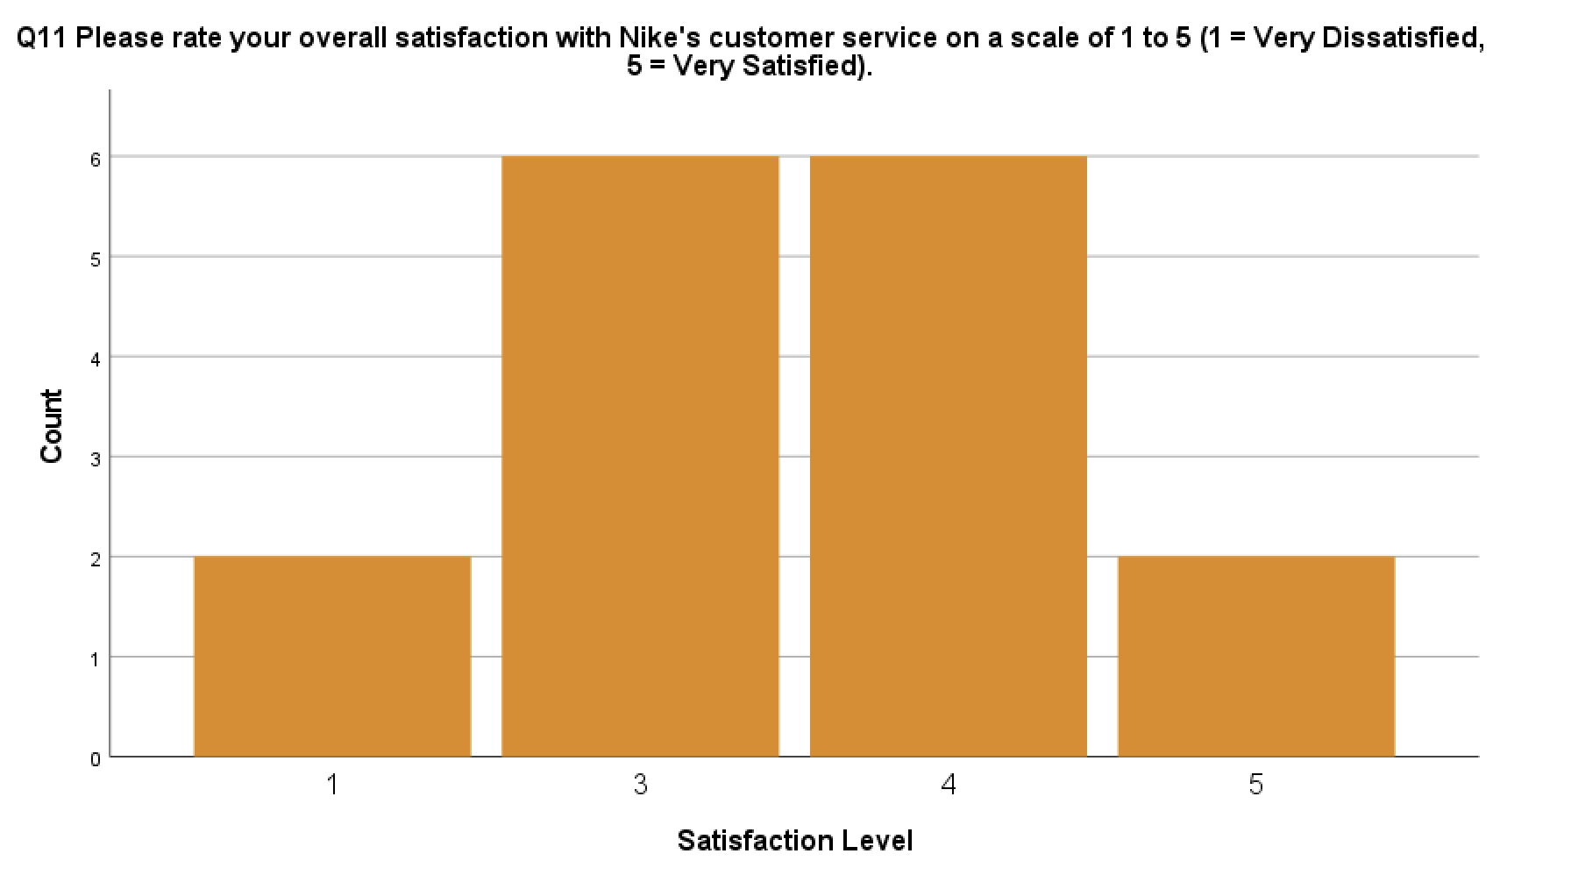
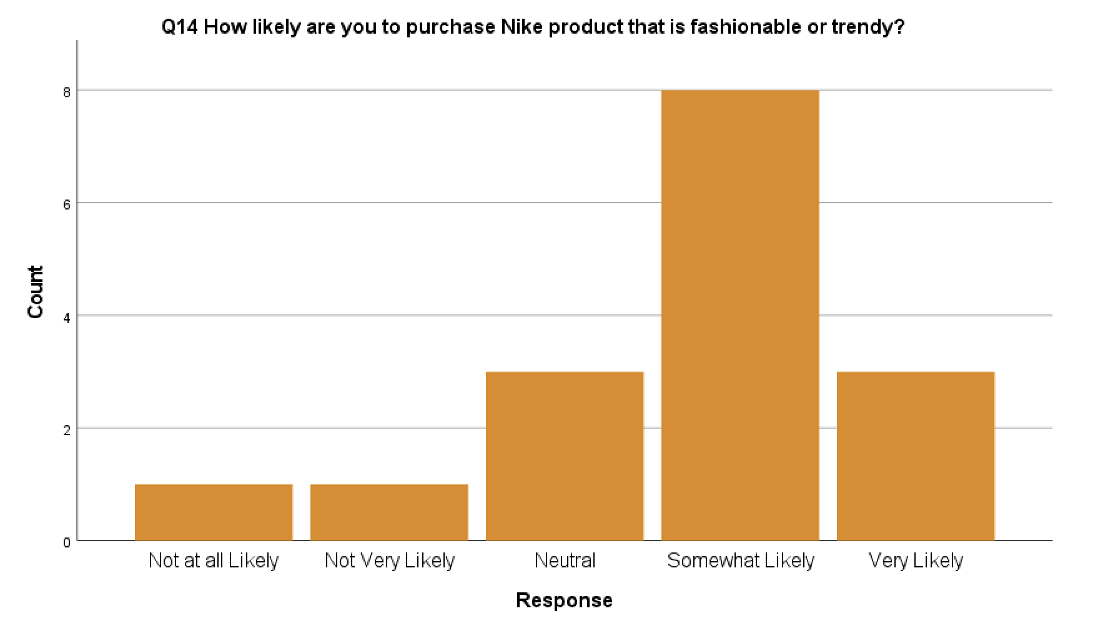
Graphs

Slide 8
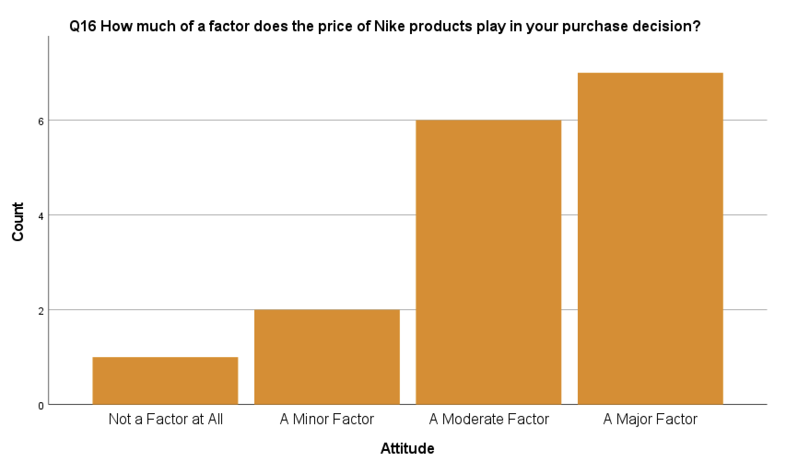
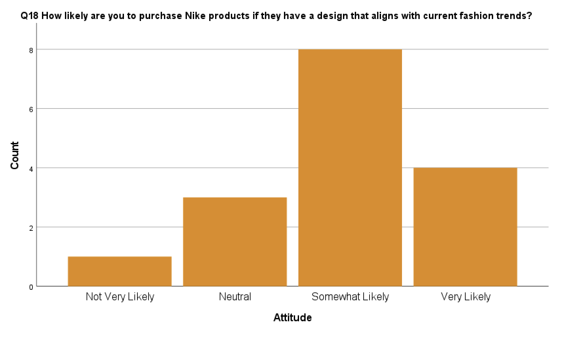
Graphs

Slide 9
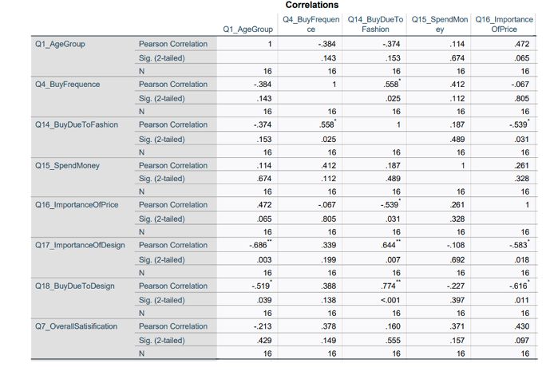
Statistical Methods-Pearson Correllation
We observe a positive and negative correlation among the variables However, the correlation is not significant among the variables.
The highest correlation observed among the variables is between buy due to design and overall satisfaction

Slide 10
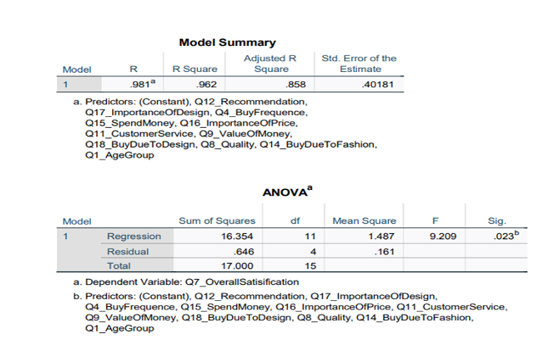
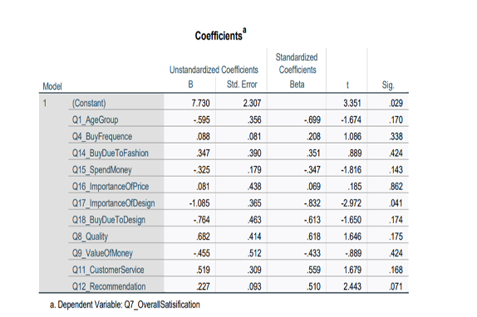
Statistical Methods-Linear regression
The R Square of 0.962 implies that it is a moderately effective model.
Significance level is 0.023and hence the relationship is significant.

Slide 11
Limitations
Limited data availability: The data available to researchers may be limited due to confidentiality concerns, proprietary information, or data privacy regulations. This could restrict the scope and depth of the research, as well as the accuracy of the findings.
Time constraints: Conducting thorough research takes time, and there may be a limited timeframe available to complete the project. This could lead to a rushed or incomplete analysis, potentially compromising the quality of the research.
Resource constraints: Conducting research can be costly, and there may be limited resources available to fund the project. This could limit the ability to collect comprehensive data, conduct extensive analysis, or hire specialized expertise.
Generalizability of findings: The findings of a research project may not be generalizable to other contexts or populations beyond Nike's products and markets. This could limit the usefulness of the research for other companies or industries

Slide 12

Conclusions
In conclusion, a Nike shoes and apparels research project has the potential to provide valuable insights into the company's operations, market position, and consumer preferences.
However, the project may face limitations in terms of data availability, time and resource constraints, ethical concerns, and generalizability of findings.
Nonetheless, by addressing these limitations and conducting thorough and well-designed research, the project could yield valuable recommendations for Nike on how to improve its products, sustainability practices, marketing strategies, and global reach.
Ultimately, the success of the research project will depend on the quality of the research design, the availability and accuracy of the data collected, and the rigor of the analysis conducted.

Slide 13
Recommendations
Nike should invest in environmentally friendly materials and production procedures. Manufacturing could employ recycled resources, biodegradable fabrics, and green energy.
Nike should strengthen supply chain management and labor policies to treat workers ethically and reduce supply chain interruptions. Improving worker safety, transparency, and labor conditions in international factories are examples.
To diversify its revenue streams and reach new consumers, Nike needs expand its product ranges and target new markets. This could involve entering emerging markets, producing products for underrepresented sports categories, and targeting younger or more ecologically concerned consumers.
To improve product functioning, consumer engagement, and differentiation from competitors, Nike should continue to employ technology into its product designs and marketing efforts. Wearable technology, data analytics to identify consumer preferences and trends, and targeted marketing efforts are examples.
Strengthen brand reputation and engagement: Nike should use targeted marketing efforts, celebrity alliances, and social media interaction to boost its brand reputation and customer engagement. This might differentiate Nike, boost brand loyalty, and boost sales.

Slide 14
THANKS

